Slide 1
Pathfïnder
Waiyat Hamdani, Asil Falwalha, Elizabeth Endri
Dr. Wu - CSC 265

Slide 2
Roles
Elizabeth and Asil (Team Manager) - Vigenere Cipher Implementation and GUI
Waiyat - Socket Programming, server and GUI
Language: Python and used IDLE and PyCharm throughout
GUI - Tkinter

Slide 3
Project Design
Functionalities
Connect and chat with up to five users
The application only given to the trusted governments officials which is closed server which is safe from any other users
Encryption technique used → Vigenere Cipher
The master key has been program into the application
We created the dictionary of all characters to a number

Slide 4
Diagram
We designed it using a multi threaded server.
Client
Server
Client
Client

Slide 5
Demo and Q&A

Slide 6
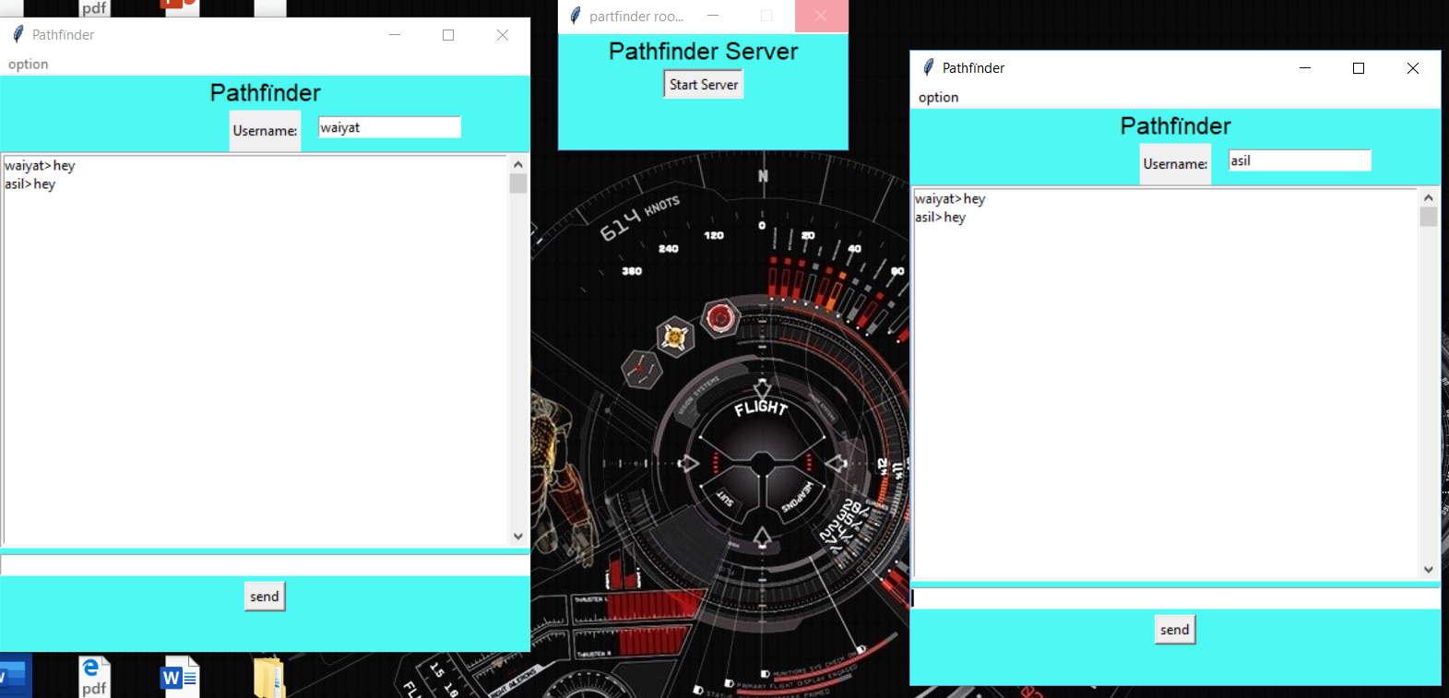
Two Person Scenario
Between 2 people just run 2 applications instead of three

Slide 7
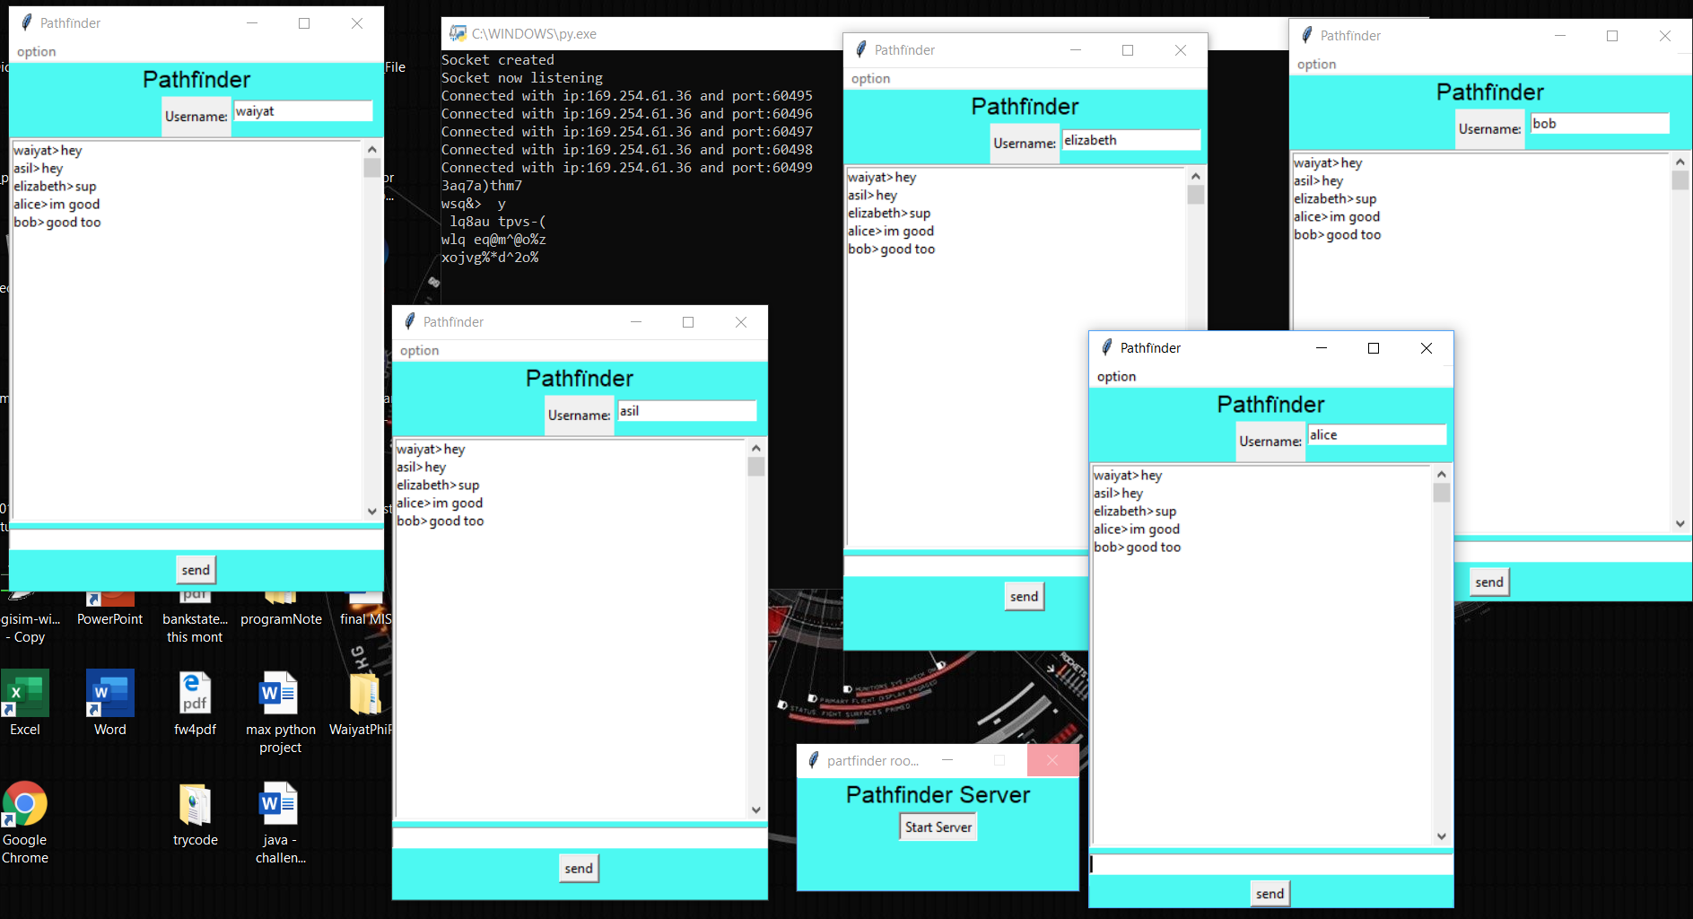
Five Person Scenario
Ciphertext

Slide 8
Future Work
Implement another algorithm possibly
Fix Bugs
Maybe use ASCII instead UTF8?

